Slide 1
Machine Learning Gym Churn Project
PRESENTED BY: Sai, Ezra, Wema, Nanda

Slide 2
Agenda
PROJECT OVERVIEW
DATA OVERVIEW AND PRE-PROCESSING
DATA TRANSFORMATION
MODEL SELECTION
RESULTS
SOLUTION

Slide 3
Project Overview
Predicting Gym Membership Churn
Membership retention is critical for gym profitability
Smaller, local gyms struggle more than major chains
High churn → high acquisition costs + unstable revenue
Goal: Use data analytics to identify members likely to cancel next month
Outcome: Provide actionable insights to improve retention and reduce cancellations

Slide 4
Business Problem & Objectives
Objectives
Identify factors linked to higher retention
Identify factors linked to higher churn risk
Build machine learning models that classify high-risk members
Support gyms in targeting at-risk members with personalized interventions
Ultimate Goal
Create a practical, data-driven retention strategy for gyms
Business Problem
Why do members leave, and can cancellations be predicted in advance?

Slide 5
Dataset Overview
Predictors Examined
Demographics: Age, gender, location
Membership Info: Type (monthly/yearly), duration
Attendance: Visits per week/month, last visit date
Engagement: Training sessions, group classes
Payments: Fees, payment method, missed payments
Customer Support: Complaints, inquiries
Target Variable
Churn: Yes (cancelled) or No (active)

Slide 6
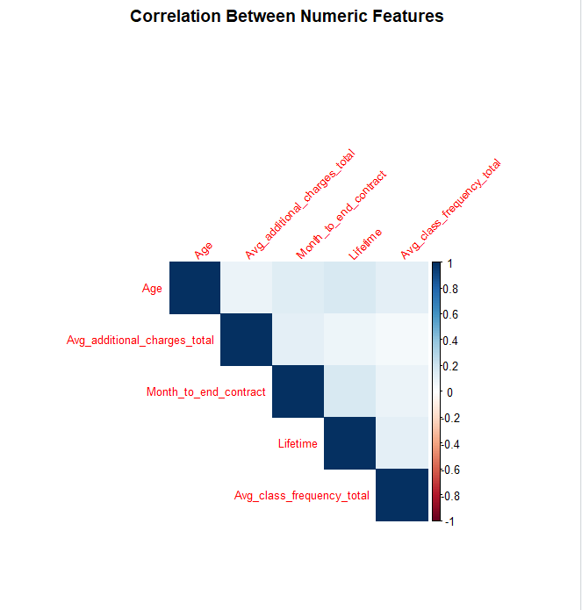
Dataset Overview
This heatmap visualizes the correlation between all numeric features in the dataset. Darker colors indicate stronger positive or negative relationships.

Slide 7

Data Pre-processing
Reviewed the dataset for missing, inconsistent, or misleading values before modeling.
Flagged missing entries with indicator columns to preserve meaningful patterns in missingness.
Imputed numerical gaps with median values and categorical gaps with the most common category.
Used a correlation matrix to identify and remove highly correlated features (above 0.90).
Resulting dataset was clean, imputed, and streamlined for reliable modeling.

Slide 8

Data Transformation & Partitioning
Converted numeric-coded fields (e.g., gender, partner offers, distance) into proper categorical variables.
Relied on logistic regression and tree-based models to naturally handle categorical data without manual dummy creation.
Skipped normalization/standardization since variables were already on similar scales.
Applied stratified sampling to maintain the same churn ratio in both training and testing sets.
Split the data 70/30, using ~2,800 rows for training and ~1,200 for testing to ensure balanced evaluation.

Slide 9
Model Selection & Formulation
Logistic Regression
Linear baseline model
Estimates log-odds of churn
Fast, interpretable
Random Forest
Ensemble of 500 decision trees
Random feature sampling (mtry = 3)
Lower variance & better generalization
Produces feature importance (Gini-based)
Decision Tree
Captures non-linear relationships
Splits based on Gini impurity
Provides a visual flow of decision logic

Slide 10
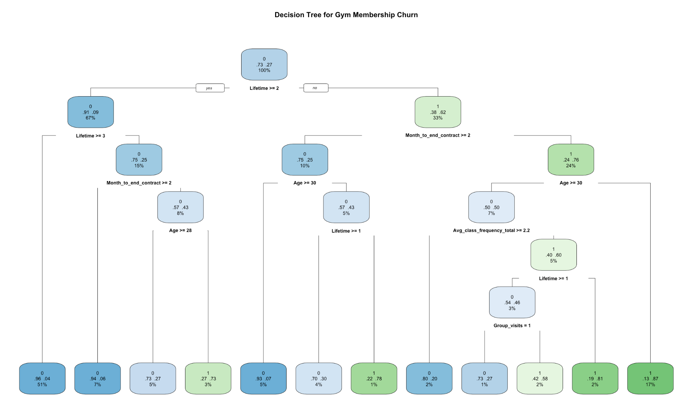
Model Selection & Formulation
This diagram visualizes the structure of the Decision Tree model used to classify churn.

Slide 11
Ensemble Models & Model Comparison
Model | TP Rate (Churn=1) | TN Rate (Stay=0) | Accuracy | Kappa
Logistic Regression | 0.8932 | 0.9240 | 0.8082 | 0.7277
Random Forest | 0.8907 | 0.9364 | 0.7642 | 0.7142
Decision Tree | 0.8824 | 0.9285 | 0.7547 | 0.6937

Slide 12
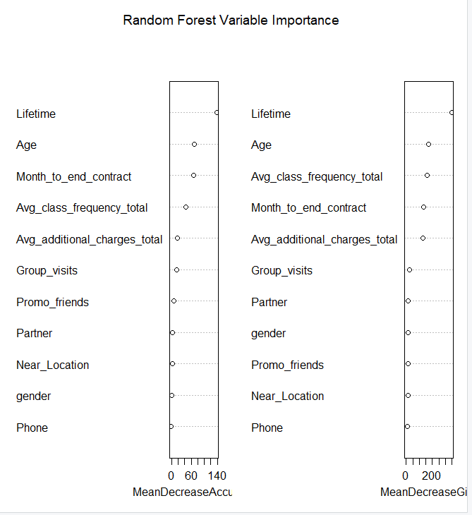
Ensemble Models & Model Comparison
This Random Forest importance plot shows the raw MeanDecreaseAccuracy and MeanDecreaseGini metrics. It provides a technical view of how the model prioritizes certain features during training.

Slide 13
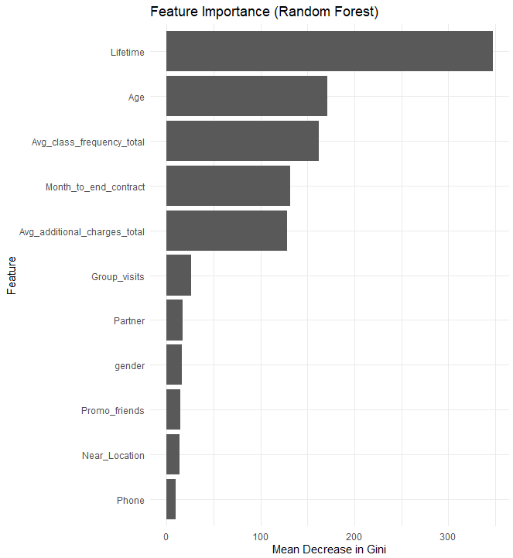
Ensemble Models & Model Comparison
This bar chart highlights the most influential predictors identified by the Random Forest model. Lifetime, Age, Class Frequency, and Membership Duration are shown to be the strongest predictors of chu

Slide 14
Results & Discussion
Model Performance
Random Forest achieved the highest sensitivity (0.9364) and strong overall accuracy (0.8907), making it the most robust and stable model for predicting churn.
Logistic Regression provided clear interpretability with meaningful coefficient directions, achieving solid accuracy (0.8932) and balanced Kappa (0.7277).
The Decision Tree, while intuitive for segmentation, had slightly lower performance (accuracy 0.8824, Kappa 0.6937) and was more prone to overfitting.
Key Insights
Engagement-driven variables—group visits, class frequency, and membership lifetime—are the strongest predictors of churn.
Demographic factors such as gender or location have minimal influence on churn outcomes.
Behavioral patterns, rather than identity, drive churn risk.
Improving engagement is the most effective lever for reducing member churn.

Slide 15
Summary & Lessons Learned
Project Takeaways
Machine learning can effectively identify high-risk churners.
Strong data preprocessing (handling missing data, correlation checks, structure review) is critical.
No single model is universally best—each offers different advantages.
Lessons Learned
Churn prediction is both a technical and business problem.
Insights must translate into practical actions (early engagement, group activities, member touchpoints).
Future improvements: more variables, advanced models (e.g., gradient boosting), cross-validation.
A real-time dashboard would make insights more actionable.

Slide 16

Thank you

